Slide 1
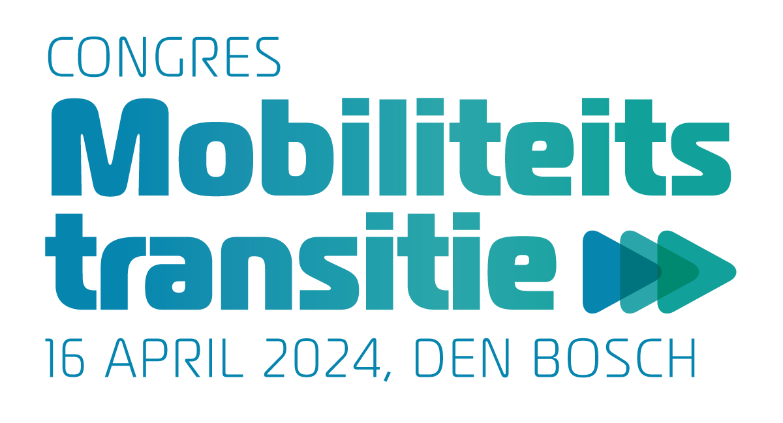
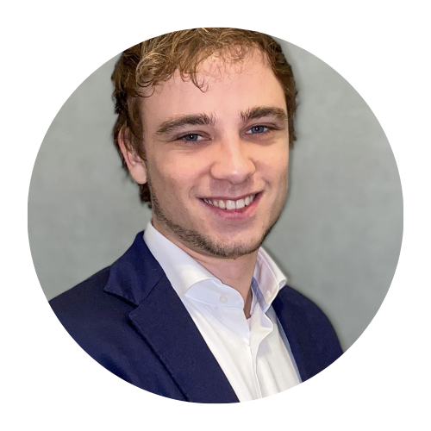
Breakout ronde 3
ZAAL 1
ZAAL 2
Mobiliteitsproblemen oplossen: lessen uit
grote Europese steden
Willem Frederik Metzelaar
Managing director & Head of Innovation Hub West | EIT Urban Mobility
Samenwerken verrijkt marktkansen voor Connected Mobility
Jeffrey van Gils
Adviseur Connected Mobility en OV | KNV|
Sessie waar u voor ingeschreven heeft, staat op uw badge

Slide 2
Mobiliteitsproblemen oplossen: lessen uit
grote Europese steden
Willem Frederik Metzelaar
Managing director & Head of Innovation Hub West | EIT Urban Mobility

Slide 3
Mobility for more liveable cities

Slide 4
Mobility in cities needs to be fundamentally changed to ﬁght the climate emergency
Notes:
The world is in the midst of a climate emergency. Following the European Commission’s 2030 Climate Target Plan, 55% of greenhouse gas emissions have to be cut by 2030 and net zero emissions achieved by 2050
As such, we need to embrace a new paradigm that includes radically changing how we move and live in cities
EIT Urban Mobility is the leading European network for transport innovation in cities and is committed to helping the EU accomplish its ambitious CO2 reduction goals

Slide 5
EIT Urban Mobility is accelerating the urban mobility transition
EUROPE
Talent to business
ECOSYSTEMS
NATIONAL
Match and
connect
Innovations to market
MOBILITY FOR MORE
LIVEABLE URBAN SPACES
CITIES
Startups to scale
Notes:
At EIT Urban Mobility, we are committed to decarbonising the mobility sector and accelerating the transition to sustainable urban mobility
we connect local, national and European ecosystems
we operate within the EU ecosystem, we align with EU priorities and contribute to implement key EU strategies and initiatives including the European Green Deal, the Cities Mission (100 climate-neutral and smart cities by 2030), Horizon Europe and New European Bauhaus
we collaborate with our partners on local projects and initiatives and establish strong relationships with regional and city governments

Slide 6
We are the largest European innovation community for urban mobility
80+ cities and regions
National governments in 35 countries
Large enterprises, SMEs, startups
950+
EU Institutions
ORGANISATIONS
Non-governmental
organisations (NGOs)
Universities
Research institutes
Students
Status: March 2024
Notes:
we are the largest European innovation community for urban mobility. Our partners and larger ecosystem of stakeholders are our main assets
our community includes:
industry – large enterprises, SMEs, including startups
universities and knowledge institutes
students
research and technology organisations
governments at local, regional, national and EU-level
non-governmental organisations (NGOs)
We are innovating with more than 950 entities in 35 countries across Europe
We collaborate with 80+ cities and regions , managing a wide variety of urban mobility issues

Slide 7
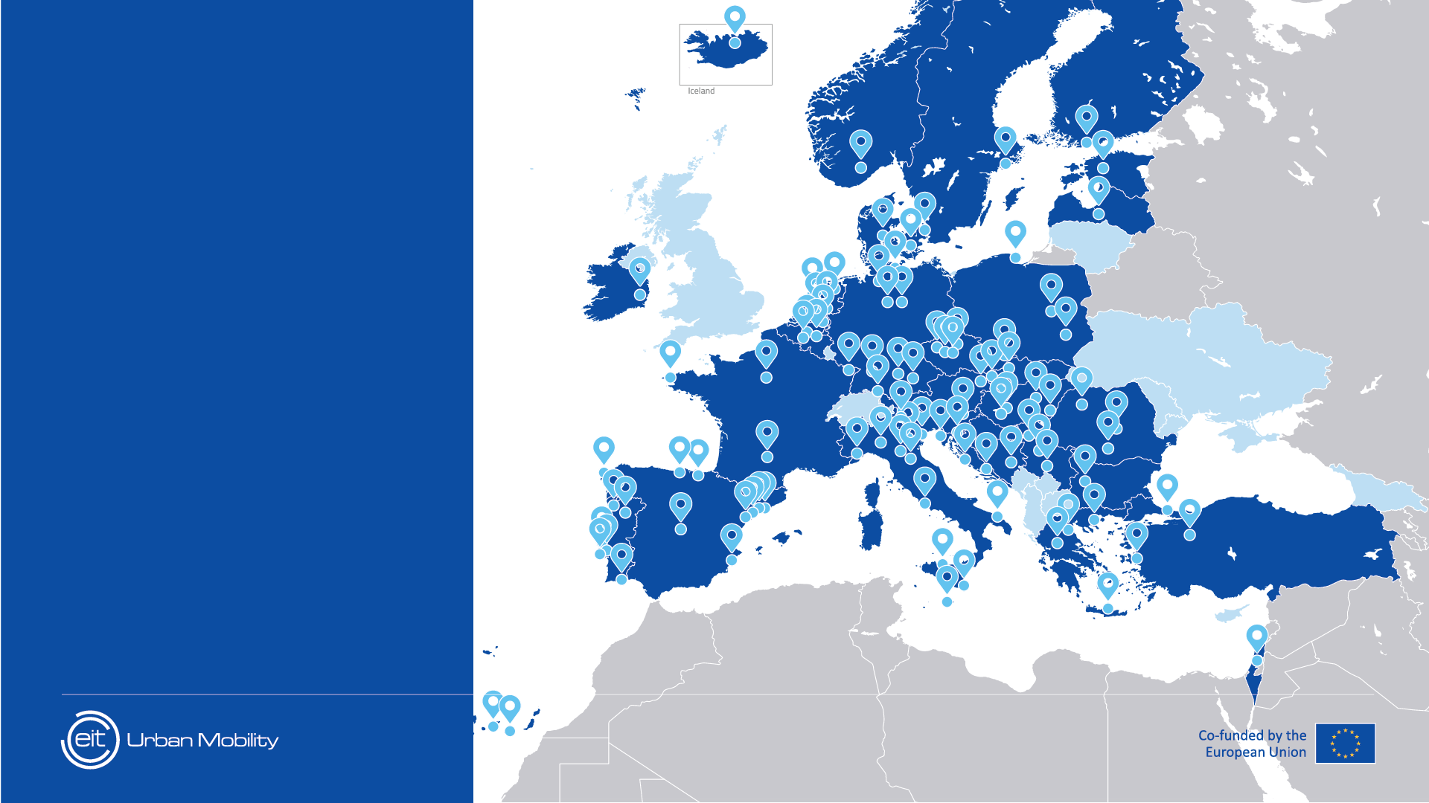
Creating impact in cities across Europe
250
pilots in
110+
cities
Status: March 2024
Notes:
we facilitate existing innovations to reach the market faster
we are unique in implementing and supporting initiatives where cities and innovators test, pilot and scale up new solutions
cities are at the heart of everything we do. We facilitate cities to deploy new solutions with the help of private sector and education partners to transition to a decarbonised and equitable mobility and transport system in Europe
we help cities find, test and implement the most appropriate solutions for their mobility challenges, across Europe
since 2020 we have facilitated implementation of 250 pilots in more than 110 cities *If you are interested in highlighting a specific city or project, take a look at the Innovation Projects 2020-2024 or the Corporate Factsheet on the Communications Library

Slide 8
We focus on innovations that
most efficiently support cities
on their way to net zero
Public transport
Electrification
Mobility data management
Urban logistics
Health and mobility
Notes:
we support cities on their journey to net zero emissions
we have five specific areas of focus that we believe our community has the potential to contribute the highest impact
these five areas are addressed through EIT Urban Mobility-funded projects as well as activities funded from other sources
these topics are:
Public transport
Electrification
Mobility data management
Urban logistics
Health and mobility

Slide 9
Our focus areas
Match and connect
Connecting private and public sector partners to access markets, talent, finance and knowledge
Talent to business
Fostering entrepreneurship through practical learning
Innovations to market
Piloting market-ready solutions in cities
Startups to scale
Boosting startup growth for long-term impact
Notes:
Match and connect
We increase impact and relevance through strong collaboration
We connect private and public sector partners with access to markets, talent, finance, and knowledge
Talent to business
We deliver tailored courses and programmes on entrepreneurship and innovation for students and professionals in the fields of urban planning, engineering, architecture, and other related fields
We have programmes for master’s and doctoral students
And for professionals looking to upskill or reskill in the field of urban mobility
Innovations to market
Some of our most successful programmes bring together established companies, startups, SMEs, research institutes to implement pilots in European cities
The pilots usually run from four to six months where market-ready solutions are tested in real-life
These have led to longer-term partnerships, growth for the private sector partners, and viable solutions for cities
Startups to scale
Through accelerator and scale-up programmes, we foster entrepreneurs to create new solutions and scale them quickly
We provide startups with access to grants and equity investments, networking opportunities, and training through partner-led programmes
We select startups that demonstrate potential to have significant positive impact socially and environmentally, as well as strong return on investment financially
Priority is given to gender-balanced startups within urban mobility
In 2023 we were named the most active investor in European urban mobility startups, and the total market capitalisation of our portfolio companies adds up to €1 billion

Slide 10
Our impact numbers
Match and connect
Talent to business
Innovations to market
Startups to scale
25,000+
visitors to Tomorrow.Mobility World Congress 2023,
our ﬂagship event
15,000+
professionals trained by Competence Hub
140+
innovation projects supported
360+
startups supported
400+
solutions showcased on our digital platform
3.7M+
views on EIT Urban Mobility learning channel (UMX)
100+
new solutions introduced to the market
€250M+
of investment raised by
our venture investment startups portfolio
Status: March 2024
Notes:
Match and connect:
Our flagship event, Tomorrow.Mobility World Congress, brought together 25,000+ visitors in 2023
Meanwhile, our Mobility Innovation Marketplace showcases more than 400 market-ready solutions for cities to implement
Talent to business:
More than 15,000 participants to online and applied learning courses were trained in 2023
The popular WebTV channel on YouTube – Urban Mobility Explained (UMX) - has garnered 3.7+ million views since it launched
Innovations to market:
More than 100 new solutions have been introduced to the market that address critical urban mobility challenges
And, over 140 innovation projects have been supported since 2020
Startups to scale:
Since 2020, we have supported over 360 startups with access to funding, coaching and concrete opportunities through participation at events and by connecting them with city partners
Our venture startups portfolio has attracted €250+ million in further investments (equity and non-equity) from other sources

Slide 11
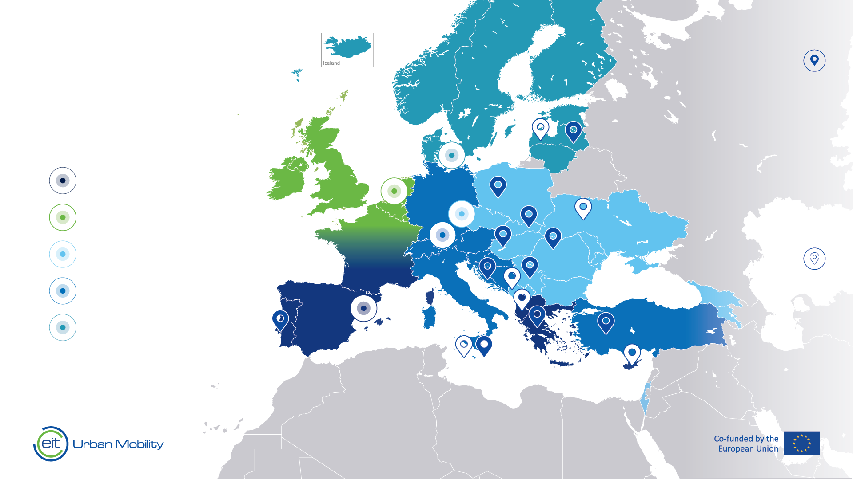
We are the leading network for urban transport innovation across Europe
Regional Innovation Scheme
EIT Urban Mobility
RIS Hub Locations
Croatia
Greece
Hungary
Latvia
Malta
Serbia
Slovakia
Poland
Portugal
Romania
Türkiye
SOUTH
Barcelona
WEST
Amsterdam
EAST
Prague
CENTRAL
Munich
NORTH
Copenhagen
HEADQUARTERS
Barcelona
EIT Community
RIS Hub Locations​
Cyprus
Latvia
Malta
Montenegro
North Macedonia
Ukraine
Status: March 2024
Notes:
We have offices across Europe and we create impact by connecting all key players in urban mobility
Our five Innovation Hubs in Barcelona, Copenhagen, Amsterdam, Prague, and Munich are the main points of contact for you to get in touch with us, and get involved in our initiatives
We support regions and cities that traditionally have faced challenges to compete in the market, through the Regional Innovation Scheme (RIS)
Currently we operate eleven EIT Urban Mobility RIS Hubs, located in Latvia, Serbia, Slovakia, Romania, Croatia, Türkiye, Malta, Greece, Portugal, Poland and Hungary
And there are an additional six EIT Community RIS Hubs in Cyrpus, Latvia, Malta, Montenegro, North Macedonia and Ukraine
We are an EU-funded organisation, innovating with more than 250 partner organisations in 35 countries
Together we form the leading European network for transport innovation in cities by being active across the continent
*to choose between slide 9, 10, and 11 based on your needs

Slide 12
Mobility in cities needs to be fundamentally changed to ﬁght the climate emergency. All cities we work with acknowledge this. All of these cities have to deal with growing density, widening gaps in health - and life expectancy, declining economic accessibility of their city in terms of inclusion (gender, ethnics, minorities). And we are all caught in several paradigmata: Status Quo Bias | The Sunk Cost Model | The Bluebottle fly effect The ‘Hidden Cost Model’ should be fought hard! Understanding the concept of Transitions
Notes:
The world is in the midst of a climate emergency. Following the European Commission’s 2030 Climate Target Plan, 55% of greenhouse gas emissions have to be cut by 2030 and net zero emissions achieved by 2050
As such, we need to embrace a new paradigm that includes radically changing how we move and live in cities
Status Quo Bias: Professor Pete Lunn (Economic and Social Research Institute, Trinity College University. It describes the tendency for individuals to favour maintaining their current choices even when better options are available.
The Sunk Cost model: investments already incurred an impossible to recover, leading to reluctance in change.
The Bluebottle Fly Effect: by Dr Eva van den Broek and marketing strategist Tim de Heijer: It’s small, irritating and hard to beat off and you can squash it, but before you know it, there’s another one flying in your living room.
Hidden Costs, are a clever way of economists to exclude costs that are basically on the balancesheet of the problem.
Transition: not only optimize what we already know, but implement real innovations or a hard stop of systems we have chosen and embraced.
All these paradigmata have for long caused inertia: the inability to change.

Slide 13
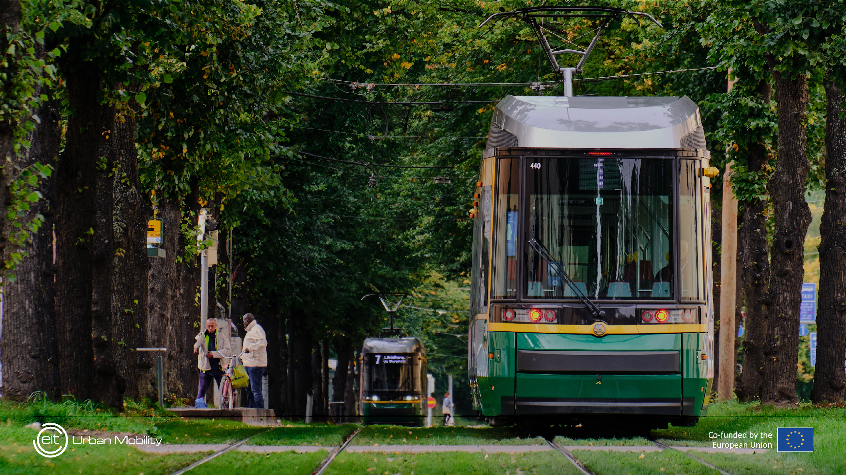
What we see all over Europe
More and more cities are speeding up as testers and implementors of innovations Some cities are true open labs for real live tests in public zones. Some cities provide true open data. But still, many are struggling in political debates. Most countries and cities are now starting to realize the need to address Procurement and challenge the current status quo
We hear more and more voices talking about Public, Private, Partnership: funding the transitions together. But also that the fear is that Corporates and SME’s can not absorp the capital! Most Countries and cities start to realize the public space is not a ‘free for all asset’. Some are acting on that notion. Most cities realize that rerouting and creating Human Centred Areas is doable Most cities see that tests with safe infrastructure, separate bike lanes, pedestrian areas, 30 km/u, smart platforms to reduce large vehicle traffic
These are actually ‘profitable’ if you take the Hidden Costs into account Many authorities have started to redefine Public Transport in order for it to become inclusive for all their citizens
We see attempts to figure out and implement the 15 minutes concept
We see a clear shift to Active Mobility, Carless areas, Road Safety (Vision Zero), a direct relation between build environment and mobility, and a need to create a clear overview of the measurements, the timing and the needed budgets.
We see more and more a bottom up approach where citizens are not invited to participate, but are actually doing the needed change themselves.
We also hear more and more is that we need to …
Notes:
To enable the transition to a sustainable urban mobility future, EIT Urban Mobility is committed to achieving net zero in cities by accelerating the implementation of existing transport and mobility innovations and creating real impact by scaling solutions
Our unique community and network of public and private stakeholders across Europe means we are the most relevant partner in the region
We are always seeking new ways to achieve these shared goals and welcome new partners to join us

Slide 14
DEEL
MEER

Slide 15
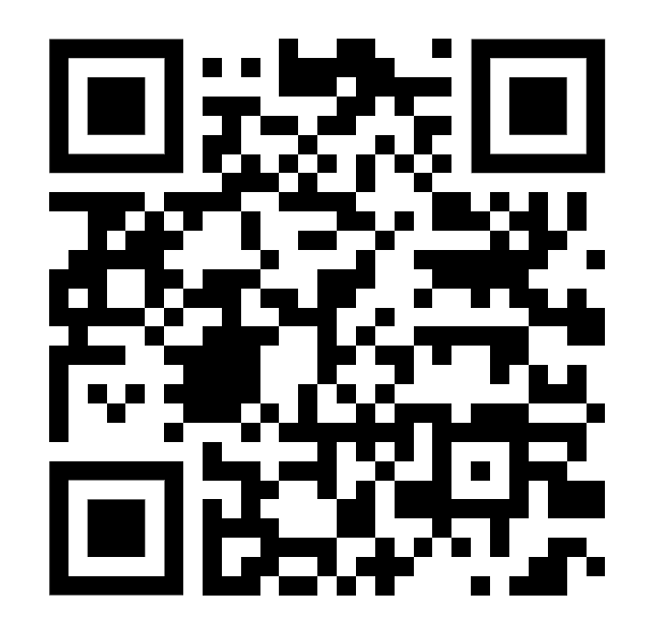
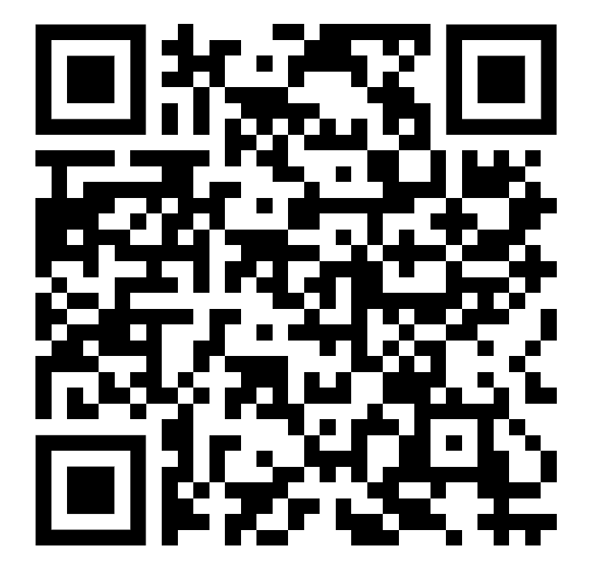
Connect with us
Notes:
Thank you!

Slide 16
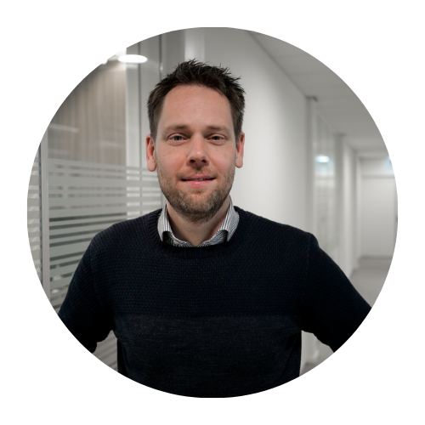
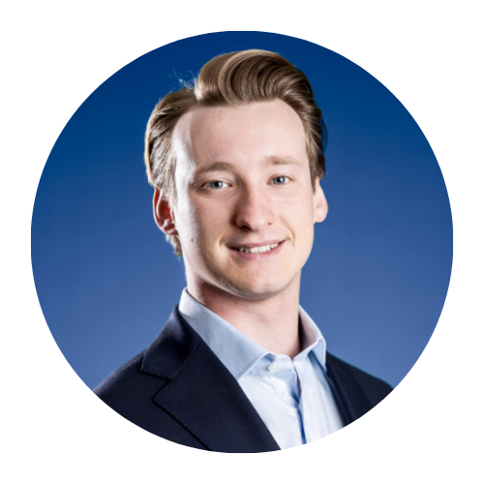
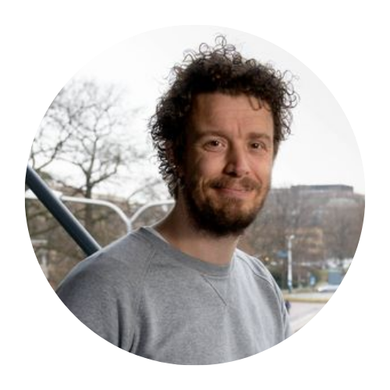
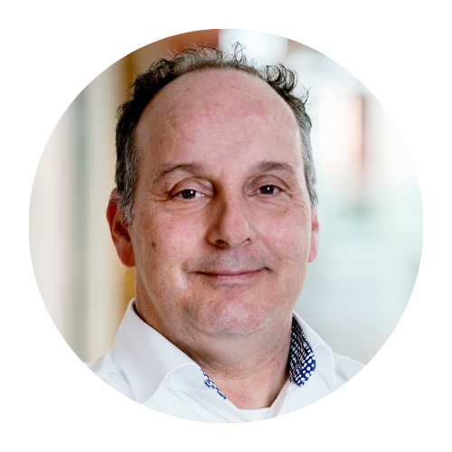
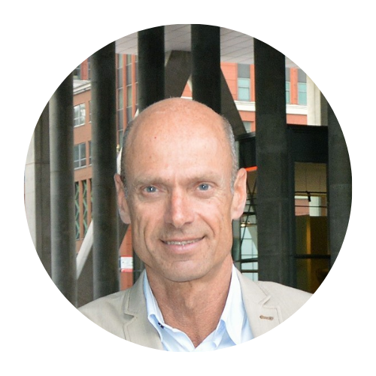
Breakout ronde 4
ZAAL 2
ZAAL 1
Wat maakt samen rijden als onderdeel van publiek vervoer aantrekkelijk?
Tobias van Muijden | Daan Stevens | Lars Meijer
Onzekere toekomst? Zo komt er toch een sterk gemeentelijk mobiliteitsplan
Vincent Marchau | Michel Dunmayer | Sander Lenferink | Liselotte Bingen
Sessie waar u voor ingeschreven heeft, staat op uw badge

